Slide 1
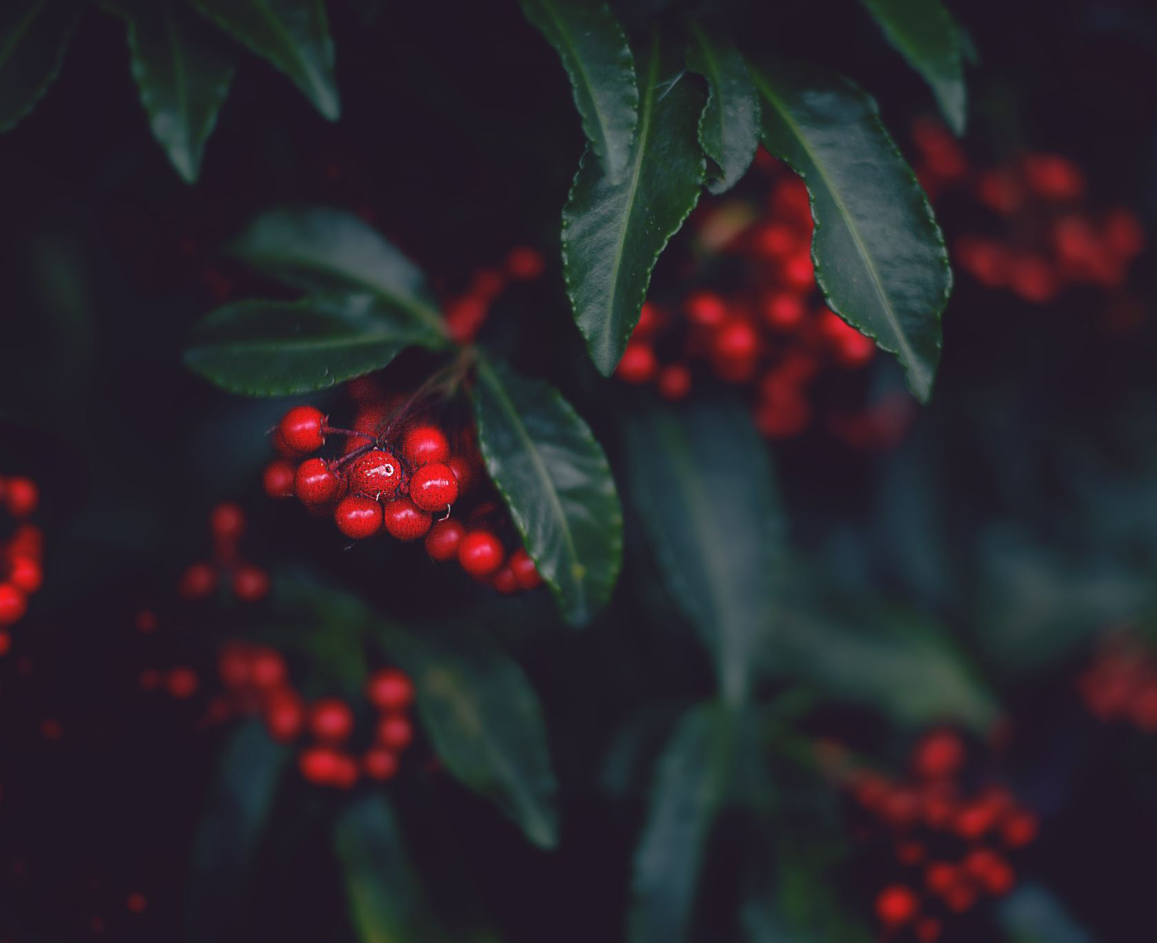
Merry Christmas
Christmas Sing-a-long with Lucio!

Slide 2
Santa claus is coming to town
Christmas Sing-A-Long

Slide 3
You better watch out You better not cry Better not pout I'm telling you why Santa Claus is coming to town

Slide 4
He's making a list And checking it twice; Gonna find out Who's naughty and nice Santa Claus is coming to town

Slide 5
He sees you when you're sleeping He knows when you're awake He knows if you've been bad or good So be good for goodness sake!

Slide 6
O! You better watch out
You better not cry
Better not pout I’m telling you why
Santa Claus is coming to town! •

Slide 7
Frosty the snowman
Christmas Sing-A-Long

Slide 8
Frosty the snowman Was a jolly happy soul With a corncob pipe And a button nose and Two eyes made out of coal

Slide 9
Frosty the snowman
Is a fairy tale they say
He was made of snow
But the children know
How he came to life one day

Slide 10
There must have been some magic
In that old silk hat they found
For when they placed it on his head
He began to dance around

Slide 11
Frosty the snowman
Was alive as he could be
And the children say he could laugh and play
Just the same as you and me

Slide 12
Frosty the snowman
Knew the sun was hot that day
So he said, “Let’s run and we’ll have some fun
Now before I melt away.”

Slide 13
Down through the village
With a broomstick in his hand
Running here and there all around the square
Saying, “Catch me if you can!”

Slide 14
He led them down the streets of town
Right to the traffic cop
And he only paused a moment when
He heard him holler, “STOP!”

Slide 15
Frosty the snowman had to hurry on his way
But he waved goodbye
Saying, “Don’t you cry…
I’ll be back again someday!”

Slide 16
Thumpity thump thump Thumpity thump thump Look at Frosty go!
Thumpity thump thump Thumpity thump thump Over the hills of snow! •

Slide 17
Jingle bells
Christmas Sing-A-Long

Slide 18
Jingle bells Jingle bells Jingle all the way Oh, what fun It is to ride In a one-horse open sleigh (Repeat)

Slide 19
Dashing through the snow In a one-horse open sleigh O’er the fields we go Laughing all the way Ha ha ha

Slide 20
Bells on bobtail ring Making spirits bright What fun it is to ride and sing A sleighing song tonight … OH …

Slide 21
Jingle bells Jingle bells Jingle all the way Oh, what fun It is to ride In a one-horse open sleigh (Repeat) •

Slide 22
Jolly old st. nicholas
Christmas Sing-A-Long

Slide 23
Jolly old St. Nicholas, Lean your ear this way! Don't you tell a single soul, What I'm going to say

Slide 24
Christmas Eve is coming soon; Now you dear old man, Whisper what you'll bring to me: Tell me if you can.

Slide 25
When the clock is striking twelve, When I'm fast asleep, Down the chimney broad and black, With your pack you'll creep

Slide 26
All the stockings you will find Hanging in a row; Mine will be the shortest one, You'll be sure to know.

Slide 27
Johnny wants a pair of skates,
Susy wants a dolly; Nellie wants a story book;
She thinks dolls are folly;

Slide 28
As for me, my little brain, isn't very bright; Choose for me, old Santa Claus.
What you think is right. •

Slide 29
Rudolph the red- nosed reindeer
Christmas Sing-A-Long

Slide 30
Rudolph, the red-nosed reindeer Had a very shiny nose. And if you ever saw him, You would even say it glows.

Slide 31
All of the other reindeer Used to laugh and call him names. They never let poor Rudolph Join in any reindeer games.

Slide 32
Then all the reindeer loved him As they shouted out with glee, Rudolph the red-nosed reindeer, You'll go down in history!

Slide 33
Then one foggy Christmas Eve Santa came to say: "Rudolph with your nose so bright, Won't you guide my sleigh tonight?” •

Slide 34
Deck the halls
Christmas Sing-A-Long

Slide 35
Deck the hall with boughs of holly Fa, la, la, la, la, la, la, la, la! 'Tis the season to be jolly Fa, la, la, la, la, la, la, la, la!

Slide 36
Fill the mead cup, drain the barrel Fa, la, la, la, la, la, la, la! Troul the ancient Christmas carol Fa, la, la, la, la, la, la, la!

Slide 37
See the flowing bowl before us Fa, la, la, la, la, la, la, la, la! Strike the harp and join the chorus Fa, la, la, la, la, la, la, la, la!

Slide 38
Follow me in merry measure Fa, la, la, la, la, la, la, la! While I sing of beauty's treasure Fa, la, la, la, la, la, la, la, la! •

Slide 39
White christmas
Christmas Sing-A-Long

Slide 40
I'm dreaming of a white Christmas Just like the ones I used to know Where the treetops glisten, And children listen To hear sleigh bells in the snow.

Slide 41
I'm dreaming of a white Christmas With every Christmas card I write May your days be merry and bright And may all your Christmases be white

Slide 42
The twelve days of christmas
Christmas Sing-A-Long

Slide 43
On the first day of Christmas, My true love sent to me A partridge in a pear tree.

Slide 44
On the second day of Christmas, My true love sent to me Two turtle doves, And a partridge in a pear tree.

Slide 45
On the third day of Christmas, My true love sent to me Three French hens, Two turtle doves, And a partridge in a pear tree.

Slide 46
On the fourth day of Christmas, My true love sent to me Four calling birds, Three French hens, Two turtle doves,
And a partridge in a pear tree.

Slide 47
On the fifth day of Christmas, My true love sent to me Five golden rings, Four calling birds, Three French hens, Two turtle doves, And a partridge in a pear tree.

Slide 48
On the sixth day of Christmas, My true love sent to me Six geese a-laying, Five golden rings, Four calling birds, Three French hens, Two turtle doves, And a partridge in a pear tree.

Slide 49
On the seventh day of Christmas, My true love sent to me Seven swans a-swimming, Six geese a-laying, Five golden rings,

Slide 50
Four calling birds, Three French hens, Two turtle doves, And a partridge in a pear tree.

Slide 51
On the eighth day of Christmas, My true love sent to me Eight maids a-milking, Seven swans a-swimming, Six geese a-laying,

Slide 52
Five golden rings, Four calling birds, Three French hens, Two turtle doves, And a partridge in a pear tree.

Slide 53
On the ninth day of Christmas, My true love sent to me Nine ladies dancing, Eight maids a-milking, Seven swans a-swimming, Six geese a-laying,

Slide 54
Five golden rings, Four calling birds, Three French hens, Two turtle doves, And a partridge in a pear tree.

Slide 55
On the tenth day of Christmas, My true love sent to me Ten lords a-leaping, Nine ladies dancing, Eight maids a-milking, Seven swans a-swimming,
Six geese a-laying

Slide 56
Five golden rings, Four calling birds, Three French hens, Two turtle doves, And a partridge in a pear tree.

Slide 57
On the eleventh day of Christmas, My true love sent to me Eleven pipers piping, Ten lords a-leaping, Nine ladies dancing, Eight maids a-milking, Seven swans a-swimming, Six geese a-laying,

Slide 58
Five golden rings, Four calling birds, Three French hens, Two turtle doves, And a partridge in a pear tree.

Slide 59
On the twelfth day of Christmas, My true love sent to me
Twelve drummers drumming, Eleven pipers piping, Ten lords a-leaping, Nine ladies dancing, Eight maids a-milking,

Slide 60
Seven swans a-swimming, Six geese a-laying
Five golden rings
Four calling birds, Three French hens,
Two turtle doves,
And a partridge in a pear tree! • whew!

Slide 61
O little town of bethlehem
Christmas Sing-A-Long

Slide 62
O little town of Bethlehem, How still we see thee lie! Above thy deep and dreamless sleep The silent stars go by.

Slide 63
Yet in thy dark streets shineth The everlasting Light; The hopes and fears of all the years Are met in thee to-night.

Slide 64
How silently, how silently
The wondrous Gift is giv’n!
So God imparts to human hearts
The blessings of His Heav’n.

Slide 65
No ear may hear His coming
But in this world of sin
Where meek souls will receive Him, still
The dear Christ enters in. •

Slide 66
Little drummer boy
Christmas Sing-A-Long

Slide 67
Come they told me,
pa rum pum pum pum A newborn King to see,
pa rum pum pum pum Our finest gifts we bring, pa rum pum pum pum

Slide 68
To lay before the King,
pa rum pum pum pum rum pum pum pum,
rum pum pum pum

Slide 69
So to honor him,
pa rum pum pum pum When we come.

Slide 70
Little Baby, pa rum pum pum pum I am a poor boy too, pa rum pum pum pum
I have no gift to bring, pa rum pum pum pum
That’s fit to give our king, pa rum pum pum pum, rum pum pum pum, rum pum pum pum

Slide 71
Shall I play for you? pa rum pum pum on my drum.

Slide 72
Mary nodded, pa rum pum pum pum The ox and lamb kept time pa rum pum pum pum I played my drum for Him pa rum pum pum

Slide 73
I played my best for Him pa rum pum pum pum rum pum pum pum rum pum pum pum

Slide 74
Then He smiled at me pa rum pum pum pum me and my drum. •

Slide 75
Silent night
Christmas Sing-A-Long

Slide 76
Silent night, Holy night
All is calm, All is bright
Round you Virgin Mother and Child
Holy infant so tender and mild
Sleep in Heavenly peace, Sleep in Heavenly peace

Slide 77
Silent night, Holy night
Shepherds quake at the sight
Glories stream from heaven afar
Heavenly hosts sing Alleluia!
Christ the Savior is born, Christ the savior is born

Slide 78
Feliz navidad!
Christmas Sing-A-Long

Slide 79
Feliz Navidad, Feliz Navidad Feliz Navidad, Próspero año y felicidad Feliz Navidad, Feliz Navidad Feliz Navidad, Próspero año y felicidad

Slide 80
I wanna wish you a Merry Christmas I wanna wish you a Merry Christmas I wanna wish you a Merry Christmas From the bottom of my heart •

Slide 81
We wish you a merry Christmas!
Christmas Sing-A-Long

Slide 82
We wish you a Merry Christmas; We wish you a Merry Christmas; We wish you a Merry Christmas and a Happy New Year.

Slide 83
Good tidings we bring to you and your kin; Good tidings for Christmas
and a Happy New Year.

Slide 84
We wish you a Merry Christmas; We wish you a Merry Christmas; We wish you a Merry Christmas and a Happy New Year. •

Slide 85
Merry Christmas to all!
Christmas Sing-A-Long

Slide 86
The end.
Christmas Sing-A-Long

